Slide 1
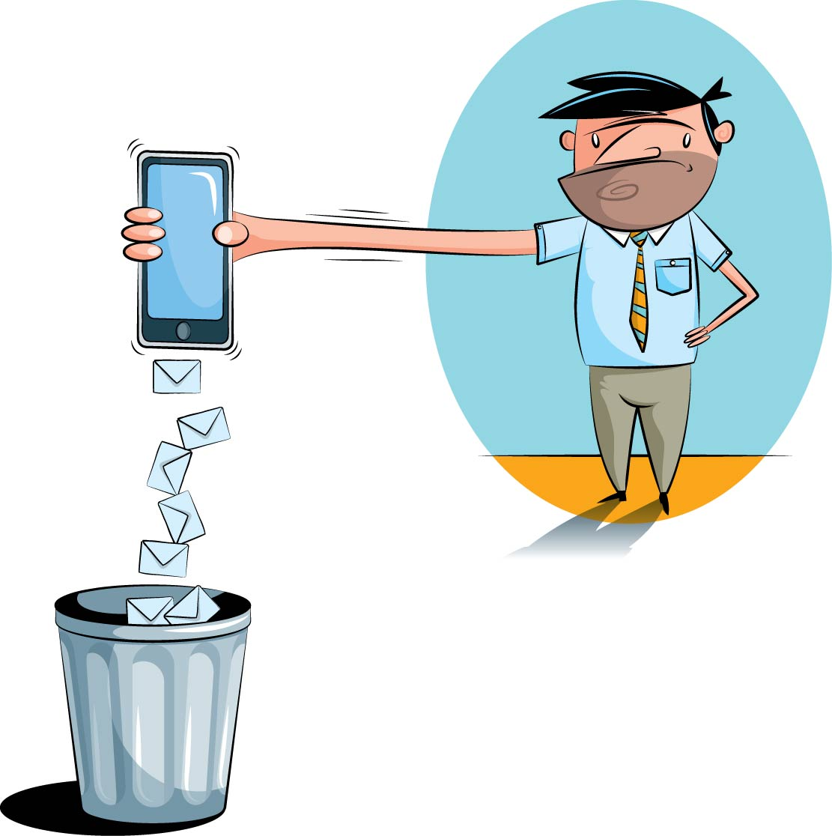
An Analysis of Spam SMS Features
Data Analysis and Research Project
Harshita Jain
n9539361
Supervisor: Dr. Guido Zuccon

Slide 2
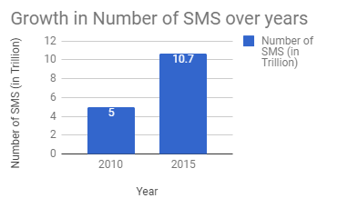
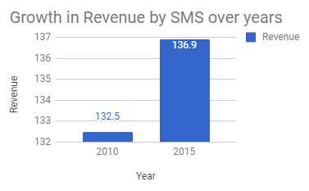
Context
Good proportion of these SMS are Spam
Found through representative data that 13% are spam SMS
Out of these, 92% of spam SMS are fraud.
Rate of receipt of spam SMS is increasing.
Time to Confirm Some Mobile User Numbers: SMS, MMS, Mobile Internet, M-News

Slide 3
Reasons and Effects
Reasons for Proliferation of Spam SMS
The availability of affordable unlimited prepaid SMS packages
Customers being more comfortable with sharing their confidential information via SMS
43% of messages were responded in the first 15 minutes of receiving them
Mobile network operators suffer a loss
Higher network costs
Higher operating costs
Increased customer care costs
Tarnished reputation
Annoying for customers
Loss of confidential and valuable personal information
Effects
Thai-English spam SMS filtering. 2010 16th Asia-Pacific Conference on Communications (APCC)

Slide 4
Gap in Previous Solutions
Simple solutions are used - Blacklisting and Spoofing/Faking Detection
Brittle by nature
Do not take content of messages into account
Perform in Ad-hoc and Post-hoc manner
Not much data available for research studies
Thai-English spam SMS filtering. 2010 16th Asia-Pacific Conference on Communications (APCC)

Slide 5
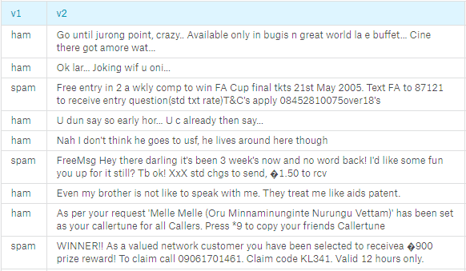
Data Set
Source: Kaggle
SMS Spam Collection

Slide 6
Project Purpose and Deliverables
Purpose of the Project:
Analyze the data to understand features that make Spam SMS different from a Legitimate SMS.
Build a predictive model which can accurately predict if an SMS is a Legitimate SMS or a Spam SMS
Project Deliverables:
R Markdown
Analysis Report

Slide 7
APPROACH
Data Analysis and Research

Slide 8
Preparation Phase
Input | Output
Acquired data from Kaggle | Key question for Analysis. Clean data.

Slide 9
Exploration Phase
Analyzed Length of Messages v/s Number of Texts for each Label
Manually Engineered Differentiating Features of Spam SMS
Verified by Producing Word Cloud for Spam SMS
Visualized Uni-Grams using Bar-Plots
Verified Bar-Plots using Random Forest
Input | Output
Clean data | Analysis of features that make a Spam SMS different from a Legitimate SMS

Slide 10
Data Preparation Phase
Prepared Data to be used to Build Predictive Models
Created a Clean Corpus by Transforming Text to Lower-Case, Removing Numbers, Stop Words, Punctuation and White Space.
Split the data into 70% Training Set and 30% Test Set
Input | Output
Clean data | Data ready to be used to build predictive models.

Slide 11
Classification Phase
Built 4 Different Classifiers for 2 Different Settings
Setting 1: Considering all features
Setting 2: Manually engineered features
Classifiers used:
Naïve Bayes
Decision Tree with Random Forest
Logistic Regression
Support Vector Machine
Compared each Classifier for each Scenario
Input | Output
Data from Data Preparation Phase | Precision, Recall, F1 and Accuracy Measures for each model in each scenario Best Scenario for each Model

Slide 12
Final Delivery Phase
Input | Output
Output from Exploration Phase Output from Classification Phase | Code in R Markdown Analysis Report

Slide 13
Work Done (1)
Exploration Phase
Analyze the data to understand the differentiating features of Spam SMS.
Explored Length of Message.
Explored words that occur most frequently in Spam SMS.

Slide 14
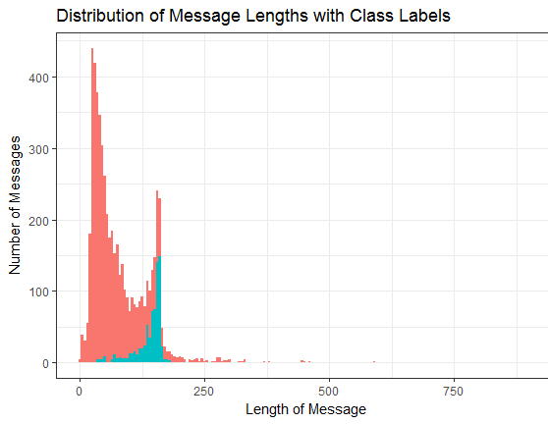
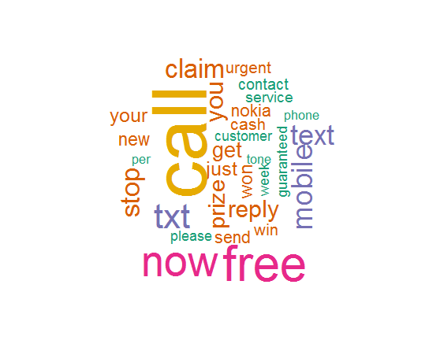
Word Cloud for Messages tagged as Spam
Distribution of Message Lengths v/s Number of Texts

Slide 15
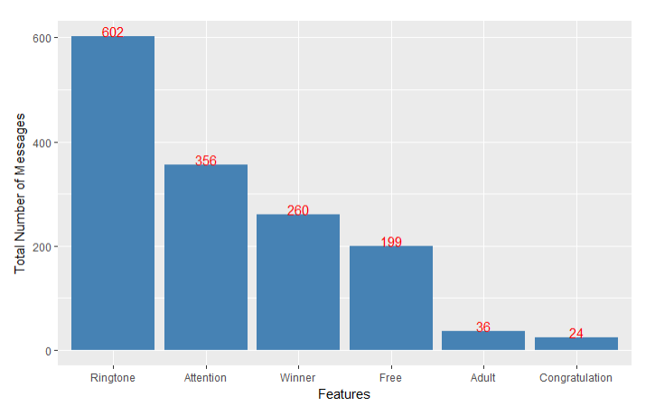
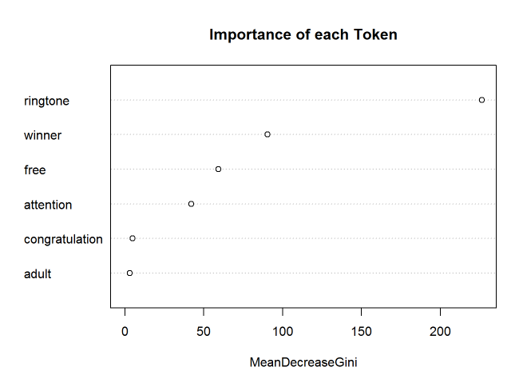
Importance of each Feature
Features v/s Number of Messages

Slide 16
Work Done (2)
Classification Phase
Build a predictive model which can accurately predict if an SMS is a Legitimate SMS or a Spam SMS.
Built 4 models using different classifiers:
Naïve Bayes
Decision Tree with Random Forest
Logistic Regression
Support Vector Machine
Built on two types of settings:
Considering all features
Manually engineered features

Slide 17
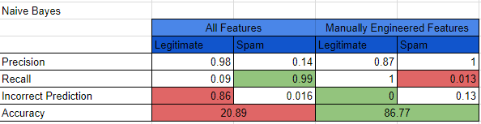
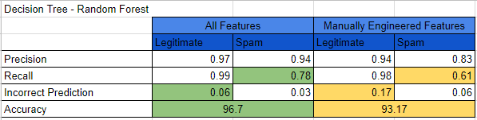

Slide 18
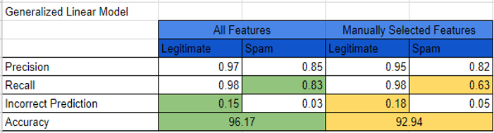
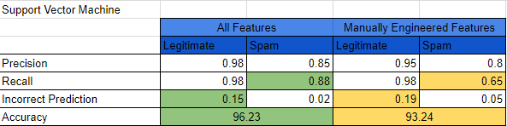

Slide 19
Implications of Work Done
Improvements in Filter System
Replace old solutions
More dynamic in nature
Benefits to Stakeholders
Mobile Network Operators
Consumers

Slide 20
Thank You!!
Any questions?

Slide 21
References
Ahonen, Tomi T. (January 13, 2011). “Time to Confirm Some Mobile User Numbers: SMS, MMS, Mobile Internet, M-News”. Communities Dominate Brands. Retrieved September 27, 2016
Global SMS traffic to reach 8.7 trillion by 2015: study. (n.d.). Retrieved August 19, 2017, from http://www.retaildive.com/ex/mobilecommercedaily/global-sms-traffic-to-reach-8-7-trillion-by-2015
Whitepapers. (n.d.). Retrieved August 19, 2017, from https://www.cloudmark.com/en/s/resources/whitepapers/sms-spam-overview
Khemapatapan, C. (2010). Thai-English spam SMS filtering. 2010 16th Asia-Pacific Conference on Communications (APCC). doi:10.1109/apcc.2010.5679770
SMS Marketing Statistics: 43% of SMS Responses Within 15 Minutes | Tatango. (2017, February 21). Retrieved August 19, 2017, from https://www.tatango.com/blog/sms-marketing-statistics-43-of-sms-responses-within-15-minutes/
SMS Spam Collection v. 1. (n.d.). Retrieved August 19, 2017, from http://www.dt.fee.unicamp.br/~tiago/smsspamcollection/

